Slide 1

Customer analysis
Target customer identification
Version 1 - an aid to facebook ads
07 June 2021

Slide 2

EXECUTIVE SUMMARY

Slide 3
EXECUTIVE SUMMARY
The focus group of Facebook marketing plan could be conducted according to summarized results:
 | Location | Target Customers to Optimize Trading Activities | Target Customers to Optimize Margin Offerings
First Option | Ho Chi Minh City | Male: age 26-45 | Male: age 26-45
Second Option | Ha Noi | Male & Female: age 31-45 | Male & Female: age 36-45
Third Option | Hai Phong | Female: age 46-50 Male: age 56-60 | Female: any age Male: age 56-60

Slide 4
Our Primary inputs
age
gender
location

Slide 5
transitional output
trading frequency
margin preference

Slide 6
how far we go in the entire project
Layer 1
Margin/Normal Customer
Individual/Deal
Customer
Pre-segmentation by trading account type
: Finished
Layer 2
Age
Gender
Location
Examine relationships between nodes to group customers by investment appetite
: In-Progress
Layer 3
Trading Frequency
Margin Preference
Stock Preference
Grouping technique tor rank our customers
Output
Group 1
Group 2
Group 3
Group 4
Risk Averse (produce less revenue)
Risk Taker (produce more revenue)

Slide 7
GEOGRAPHIC SEGMENTATION

Slide 8
note
Margin Usage Ratio in this report is only calculated for customers who have non-zero margin outstandings, the number of these customers is smaller than the number of customers who officially registered for a margin sub-account due to the fact that one could register for margin sub-account but has no margin outstandings.

Slide 9
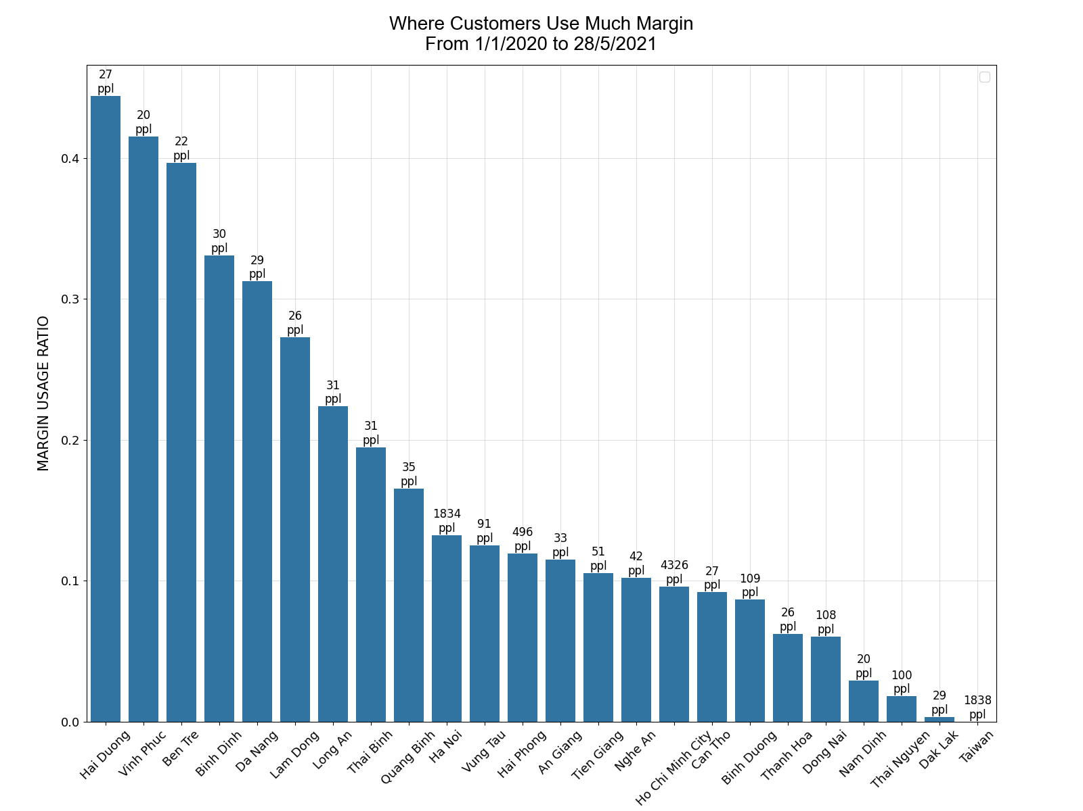
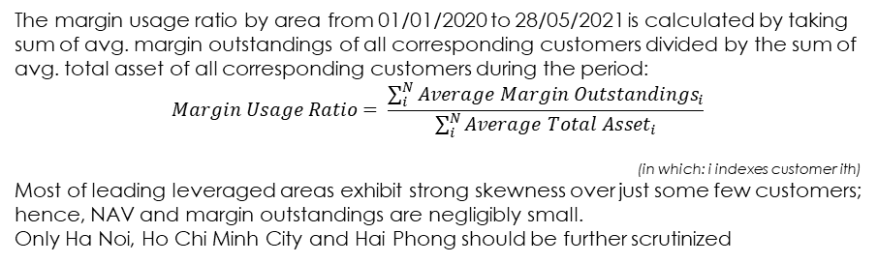
MARGIN USAGE BY area TRADING, ACTIVE, individual customers
ppl: people located in the area
The margin usage ratio by area from 01/01/2020 to 28/05/2021 is calculated by taking sum of avg. margin outstandings of all corresponding customers divided by the sum of avg. total asset of all corresponding customers during the period:
$$Margin Usage Ratio= \frac{\sum_{i}^{N}{{Average Margin Outstandings}_{i}}}{\sum_{i}^{N}{{Average Total Asset}_{i}}}$$
(in which: i indexes customer ith)
Most of leading leveraged areas exhibit strong skewness over just some few customers; hence, NAV and margin outstandings are negligibly small. Only Ha Noi, Ho Chi Minh City and Hai Phong should be further scrutinized

Slide 10
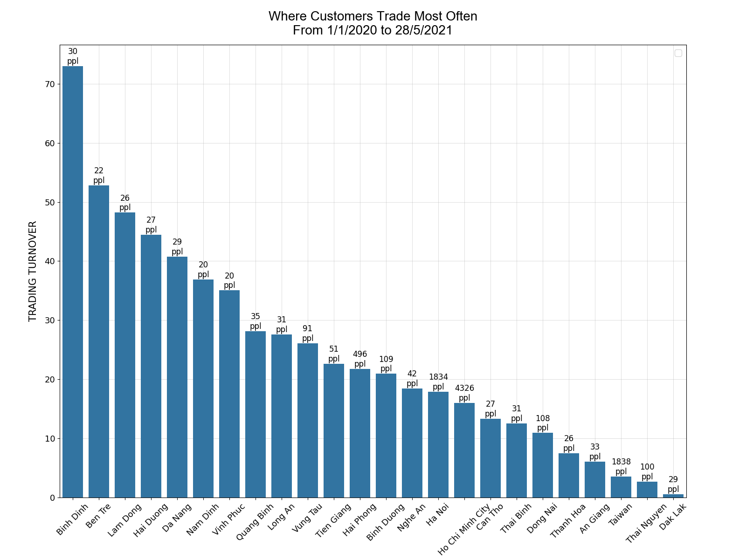
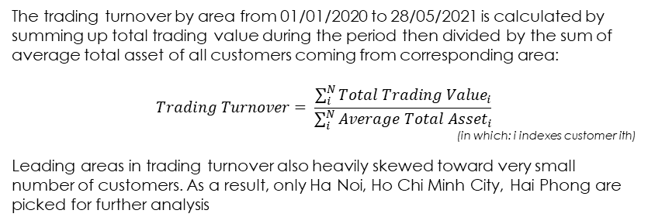
trading frequency BY area TRADING, ACTIVE, individual customers
ppl: people located in the area
The trading turnover by area from 01/01/2020 to 28/05/2021 is calculated by summing up total trading value during the period then divided by the sum of average total asset of all customers coming from corresponding area:
$$Trading Turnover= \frac{\sum_{i}^{N}{{Total Trading Value}_{i}}}{\sum_{i}^{N}{{Average Total Asset}_{i}}}$$ (in which: i indexes customer ith)
Leading areas in trading turnover also heavily skewed toward very small number of customers. As a result, only Ha Noi, Ho Chi Minh City, Hai Phong are picked for further analysis

Slide 11
key FINDINGDS
Margin Preference
Compared to other areas, Ho Chi Minh City with its biggest scale shows a little less margin usage ratio and trading turnover. Ha Noi leads in margin usage ratio and Hai Phong leads in trading turnover:
Ha Noi
Hai Phong
Ho Chi Minh City
: Market Scale
Trading Frequency

Slide 12
REGRESSION ANALYSIS ON SELECTED AREAS

Slide 13
HO CHI MINH CITY

Slide 14
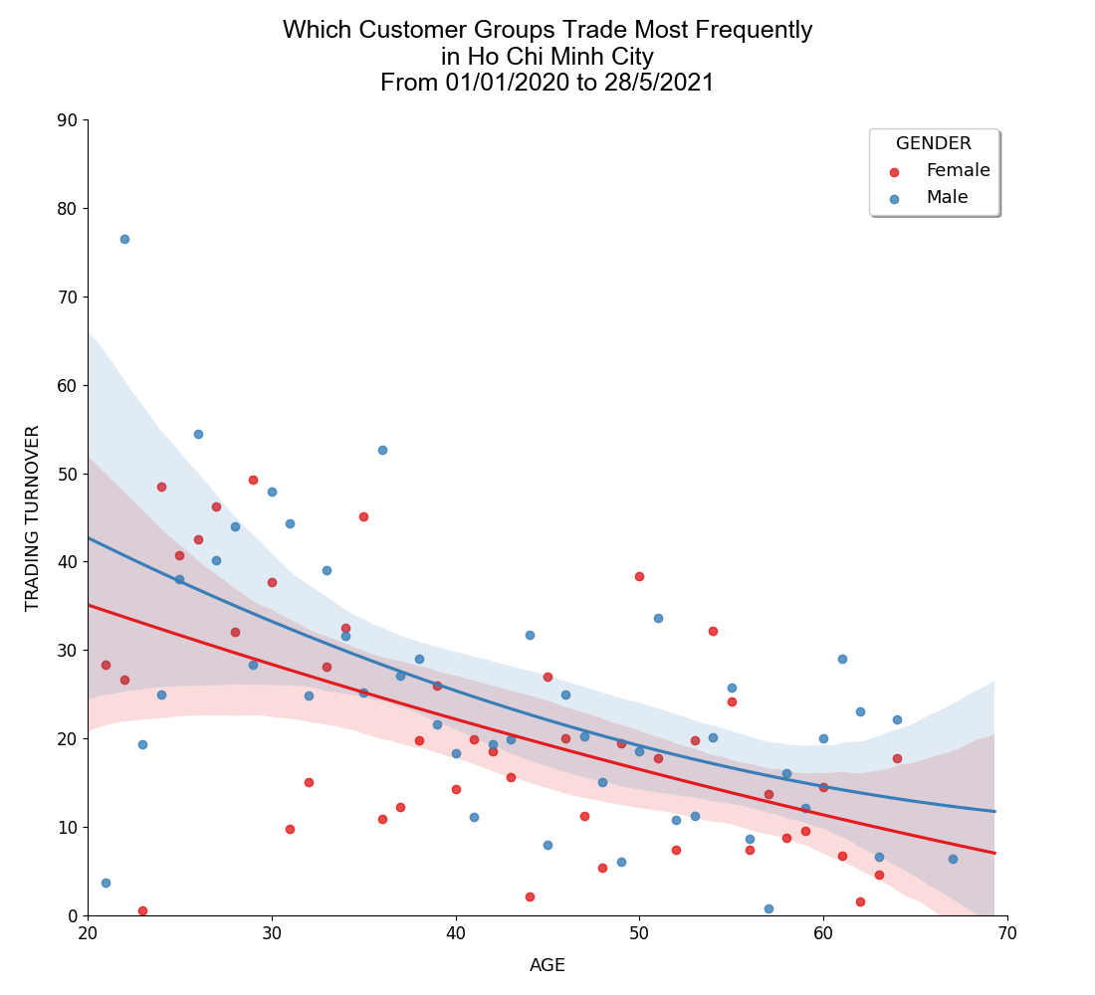
Ho chi minh city - on trading frequency TRADING, ACTIVE, individual customers
››› Next page for further analysis

Slide 15
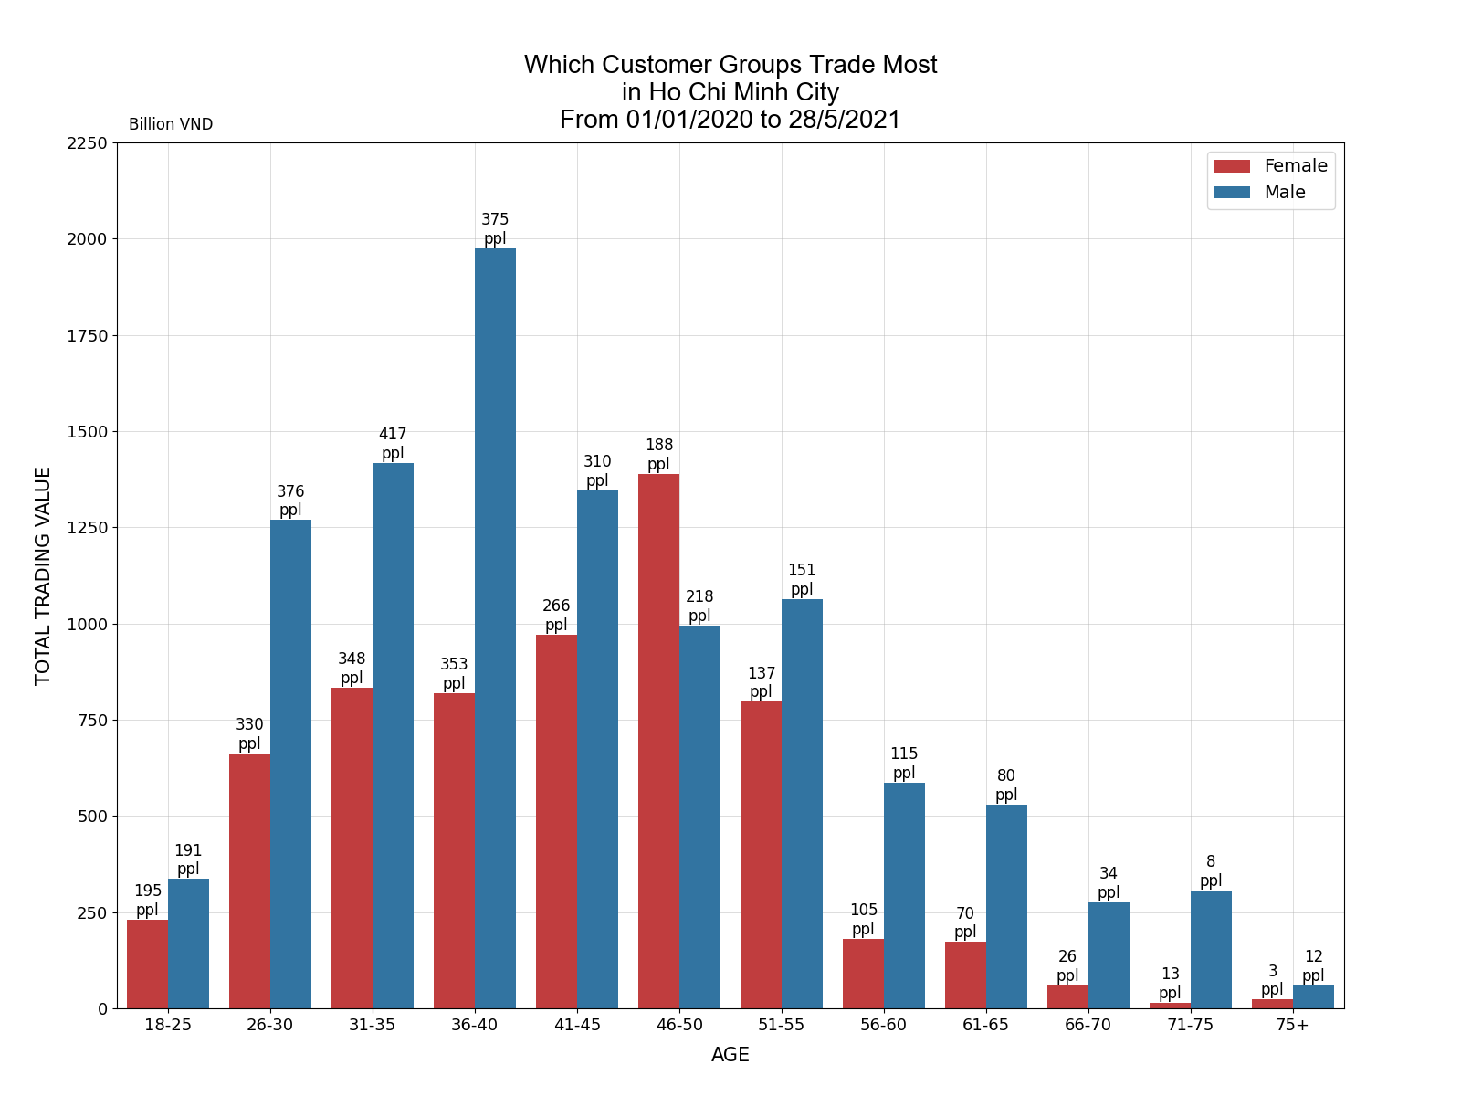
Ho chi minh city - TOTAL TRADING VALUE TRADING, ACTIVE, individual customers
ppl: people in age group
The total trading value in HCMC is disparate between men and women. Male customers surpass female customers in trading value across almost all age groups whereas the number of them in these groups are fairly comparable.
Regression analysis suggests that the difference in trading value is partly explained by trading frequency between genders. The regression line of male customers is beyond the regression line of female customers in all ages. However, there is little difference between two groups in how they change their trading behavior as they age. In general, both male and female customers tend to trade more often when they are young and decrease their frequency steadily when they get older. The rates of change in trading frequency by age are similar and almost linear.
By looking at both trading scale and trading frequency, it suffices to say that it's the group of male customers aging from 26 to 45 that we should target to in order to optimize our income from trading fee in HCMC.

Slide 16
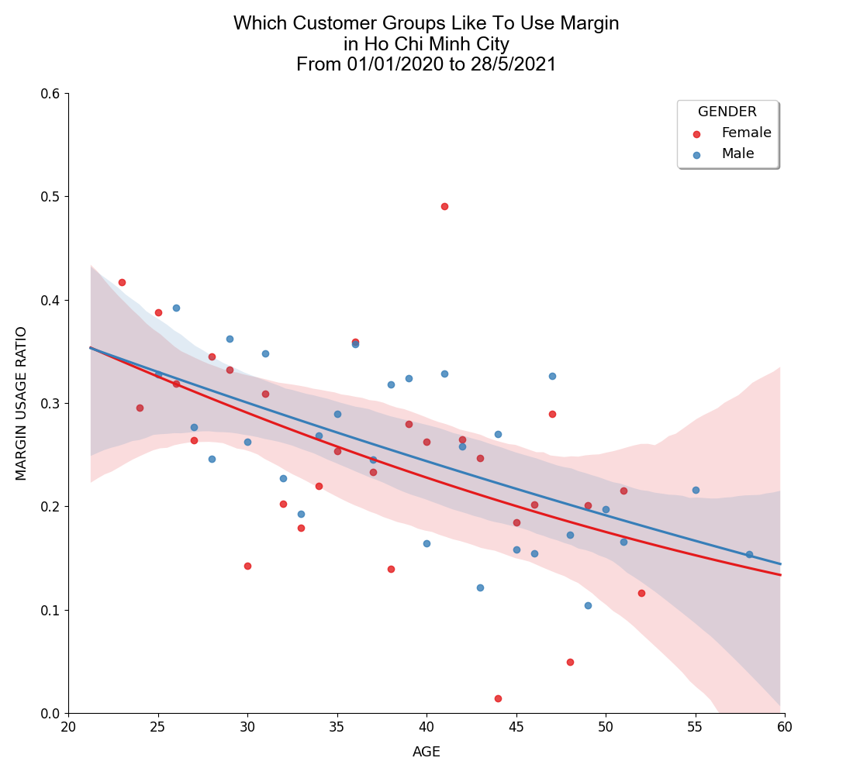
Ho chi minh city - ON MARGIN PREFERENCE TRADING, ACTIVE, individual, margined customers
››› Next page for further analysis

Slide 17
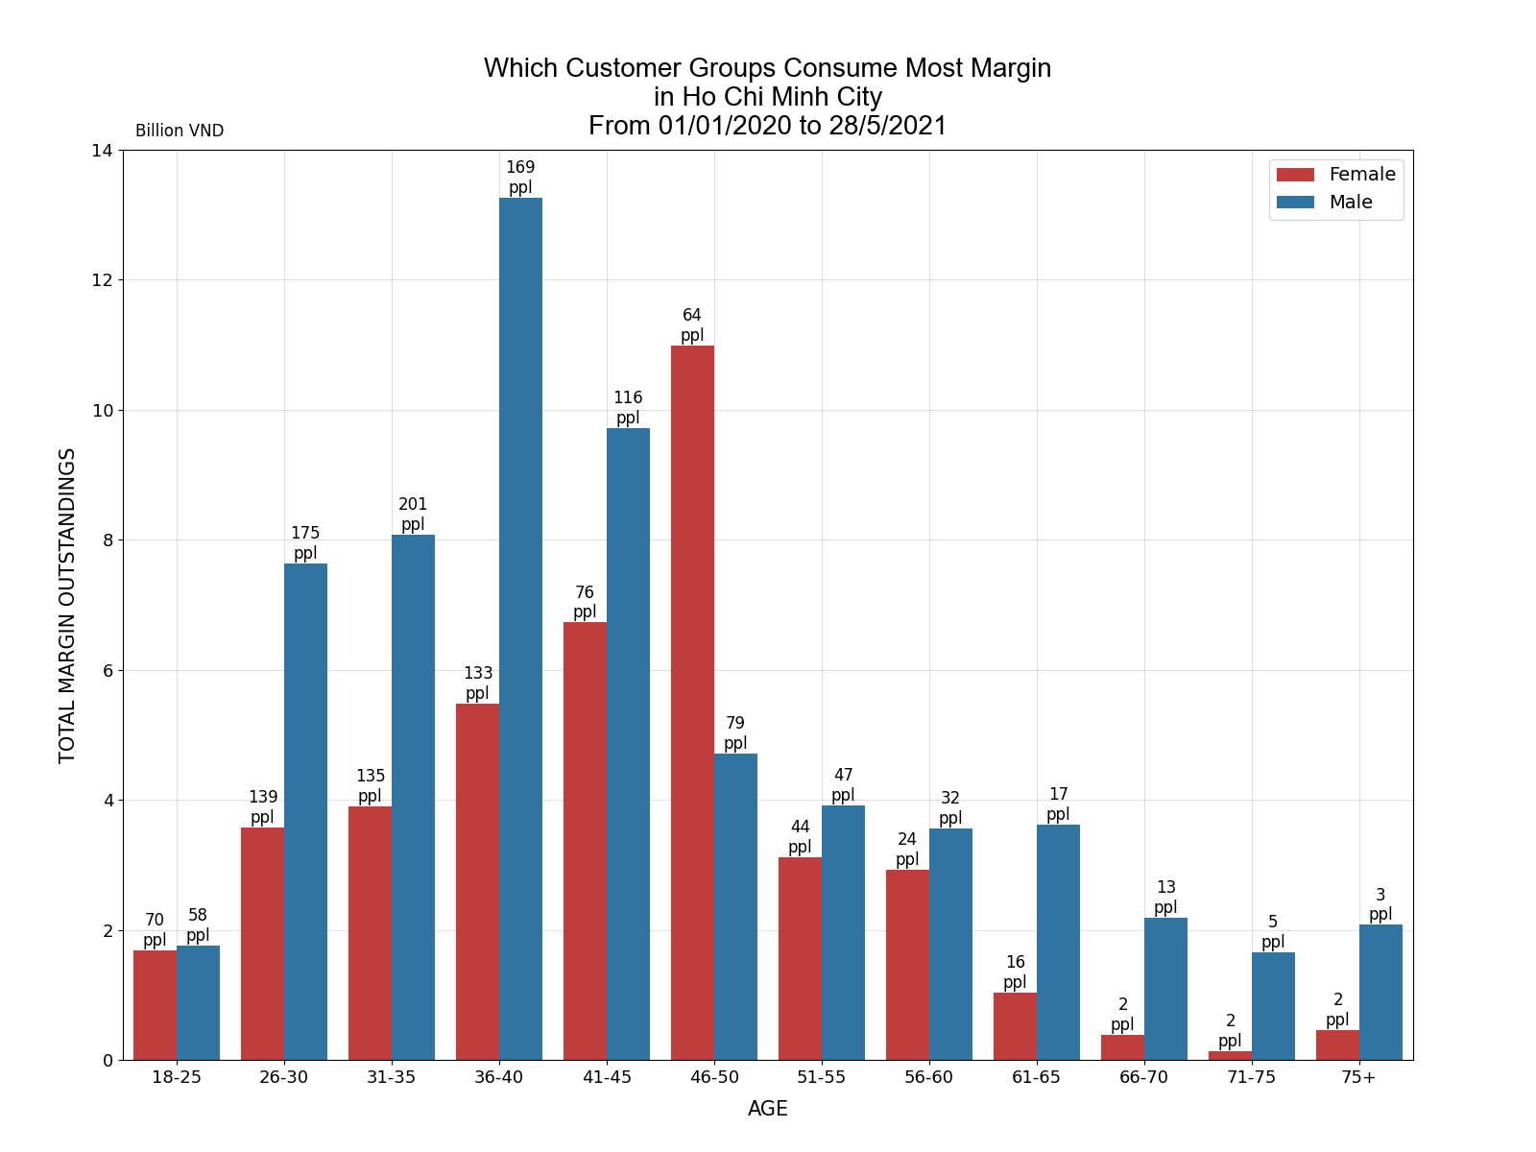
Ho chi minh city - total margin outstandingS TRADING, ACTIVE, individual, margined customers
ppl: people in age group
Male customers have greater margin balances, especially in the ages from 26 to 45. This could be because of greater number of margined male customers compared to those of margined female customers.
Notably, our regression analysis says that a typical margined male customer is somewhat identical to a typical margined female customer in term of leverage intensity. Moreover, the way they maintain this ratio through ages is not so much different: heavily leveraged in young ages and rapidly deleveraged when getting old.
By looking at both margin outstanding scale and margin usage ratios, we could conclude that it's the group of male customers aging from 26 to 45 that we should target to in order to optimize our income from margin offerings in HCMC.

Slide 18
HA NOI

Slide 19
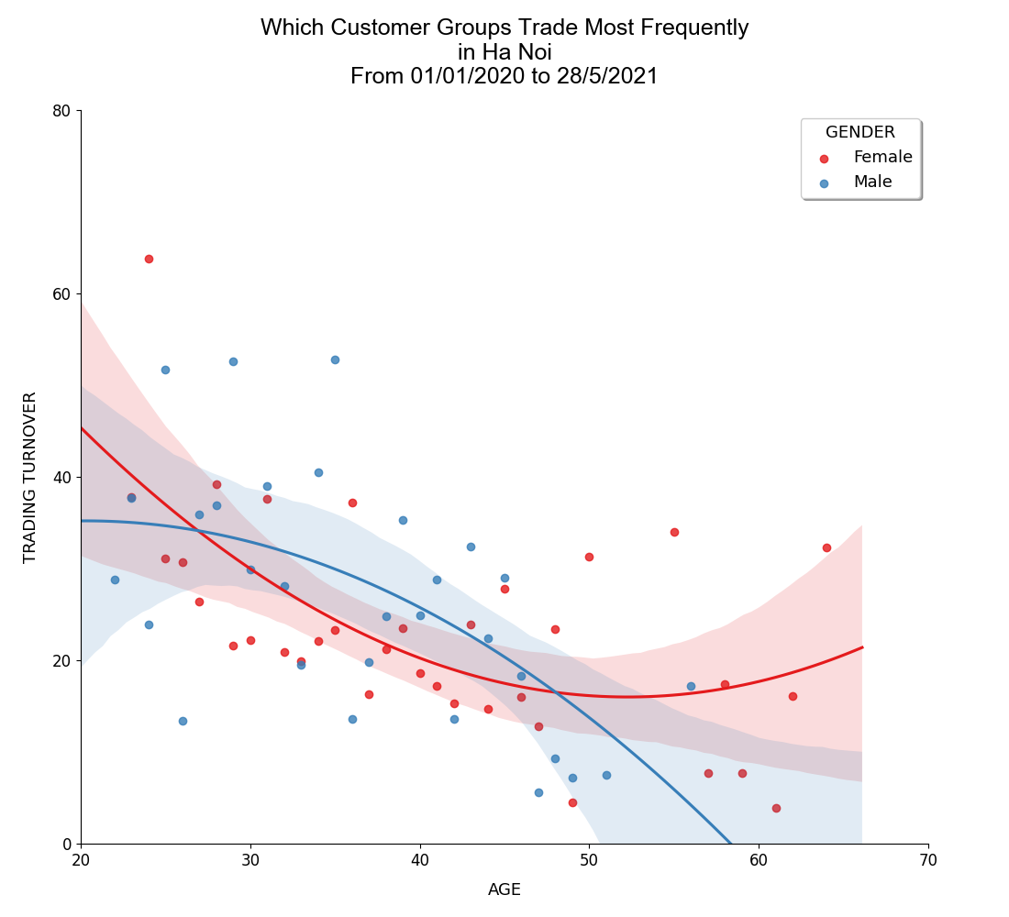
HA NOI - on trading frequency TRADING, ACTIVE, individual customers
››› Next page for further analysis

Slide 20
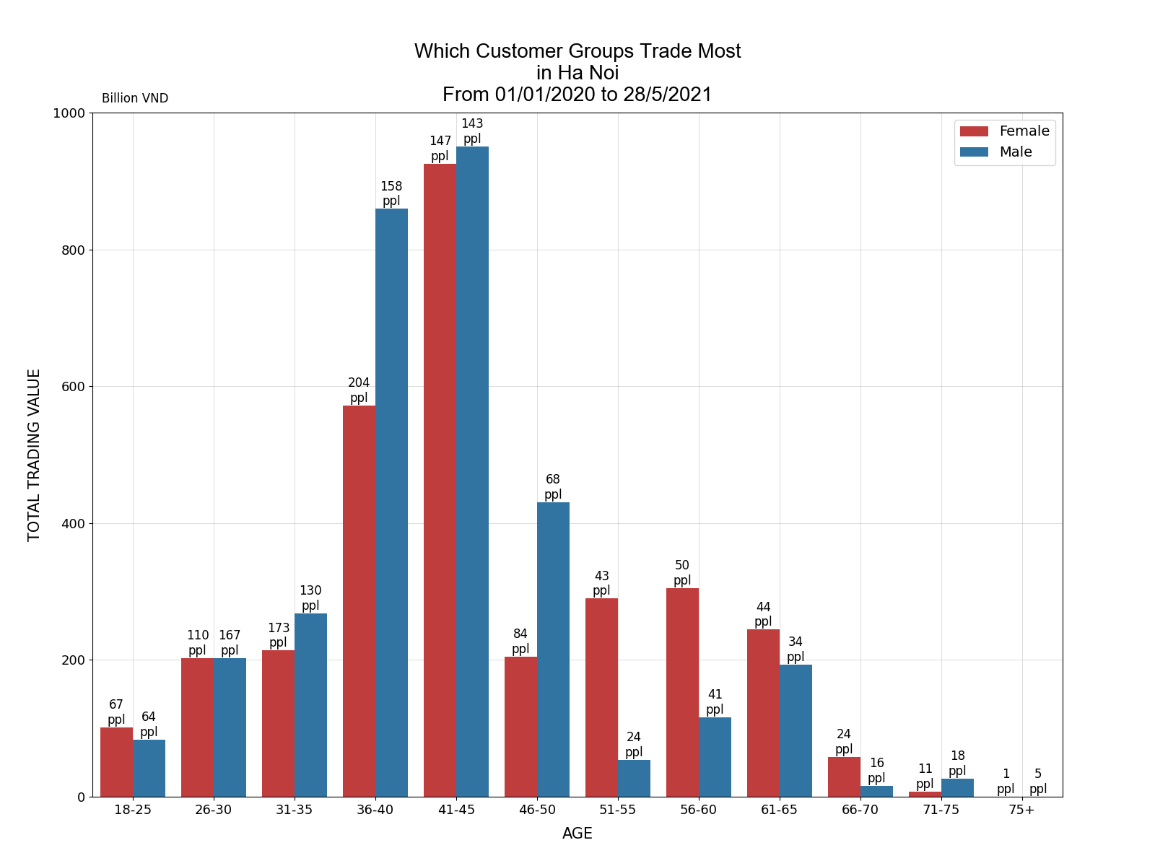
HA NOI - TOTAL TRADING VALUE TRADING, ACTIVE, individual customers
ppl: people in age group
The trading value in Ha Noi is somewhat the same between men and women in term of total amount. However, there is more female customers than male customers, revealing that total trading value per customer is little higher in males in comparison with females.
Regression analysis suggests that there seems a significant difference in their behaviors when they're getting old. While aging males tend to quickly withdraw from the stock market, females usually trades less in middle ages but seem to come back when they find themselves approaching their retirement.
Average trading value per customer is rather the same in age groups ranging from 31 to 40. It peaks at 41-45 range and decreases afterward. Combining with regression analysis, a conclusion could be made: customers age from 31 to 40 trade more frequently but with lesser scale, hence this could be actually the potential group. While customers in 41-45 often have smaller turnover but with greater scale.

Slide 21
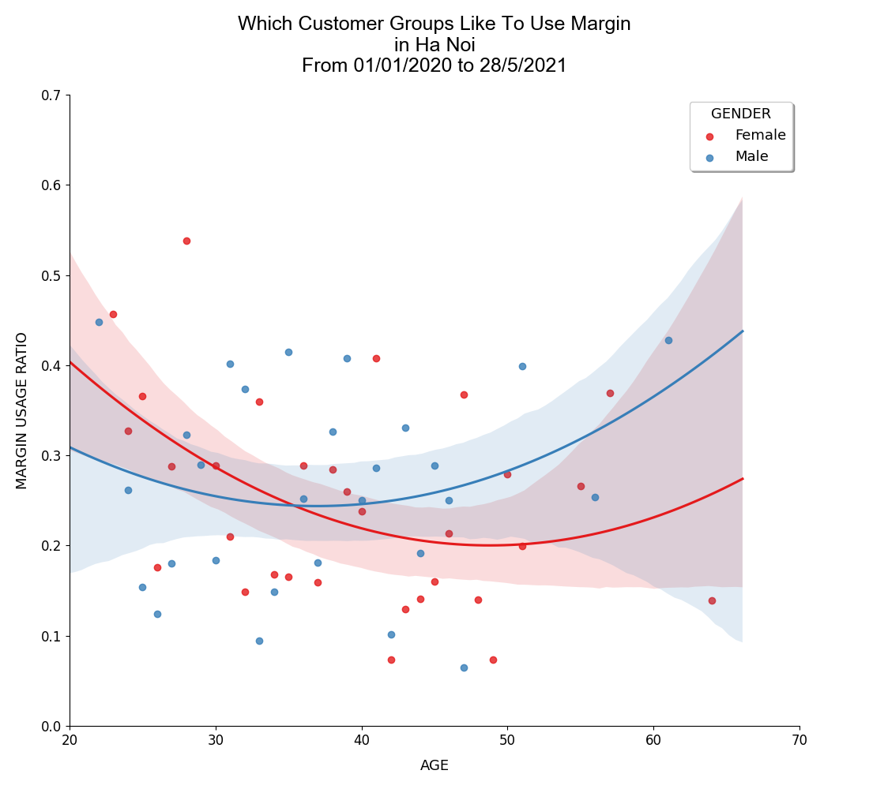
HA NOI - ON MARGIN PREFERENCE TRADING, ACTIVE, individual, margined customers
››› Next page for further analysis

Slide 22
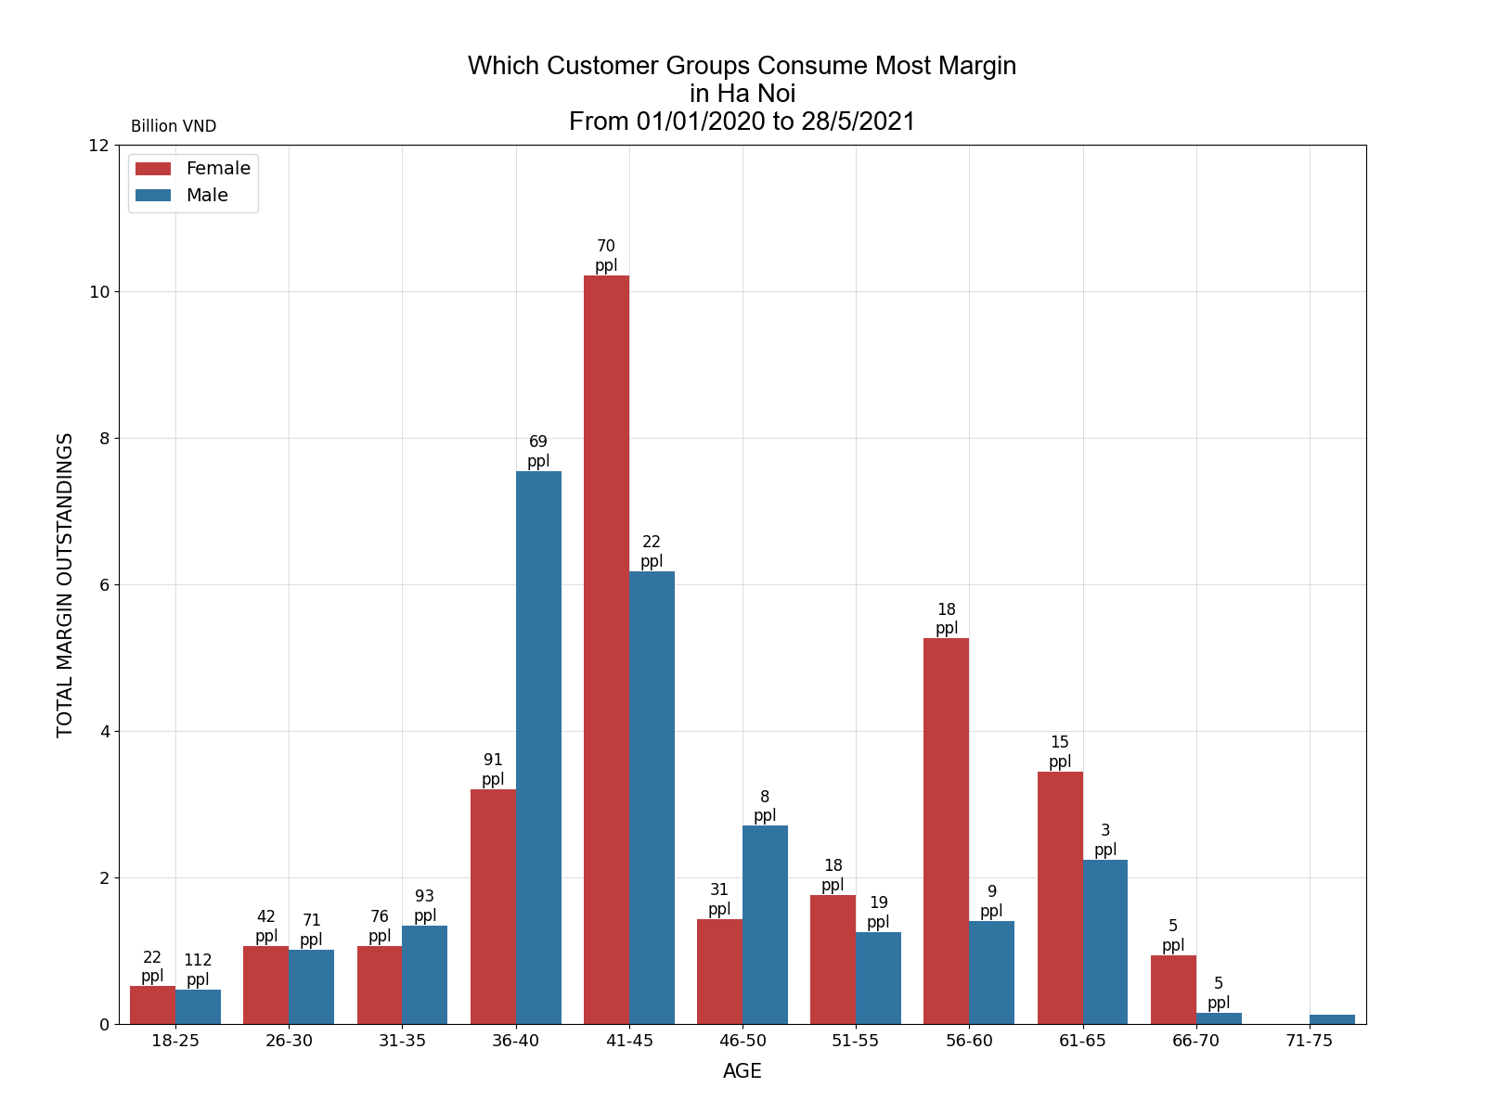
HANOI - total margin outstandingS TRADING, ACTIVE, individual, margined customers
ppl: people in age group
The left-most part of regression lines displays downward trend in margin preference on age. In spite of that, the right-most part of these lines are lifted up by just a few data points, and each of these data points stands for only very few number of customers. Hence, we can see extraordinary 95-percent confidence interval around this part. Given this much unconfidence, we only derive to the negative relationship between age and margin usage ratio from age 20 to age 50 as our findings from regression analysis.
Putting together with total margin outstandings we could see that female, and especially male customers, of age group from 36 to 45 are those who have highest average margin outstandings per capita. That means these groups are not deeply leveraged, but they are able to hold a lot of margin value due to their great NAV. As a result, we could focus on these groups to optimize our margin offering activities in Ha Noi

Slide 23
HAI PHONG

Slide 24
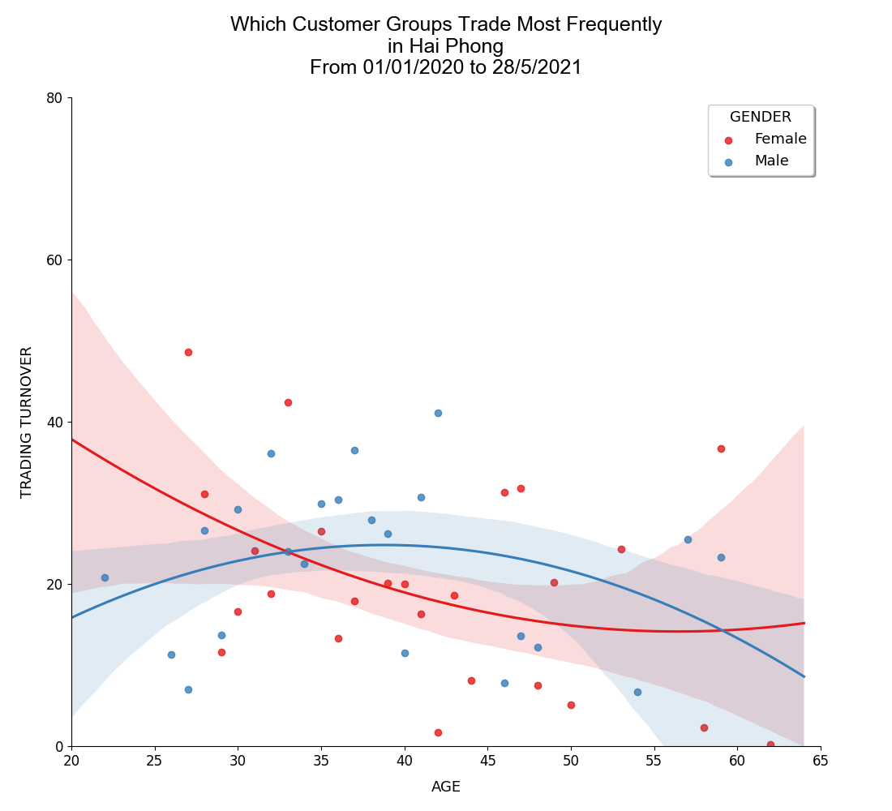
HAI PHONG - on trading frequency TRADING, ACTIVE, individual customers
››› Next page for further analysis

Slide 25
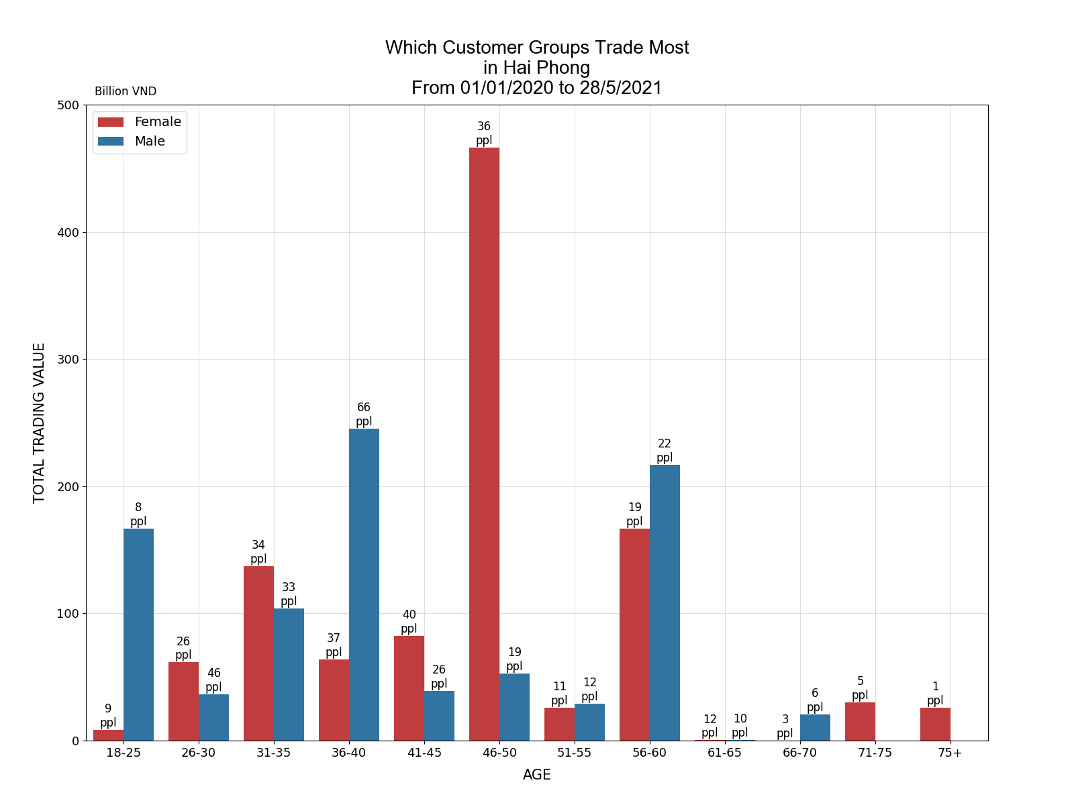
HAI PHONG - TOTAL TRADING VALUE TRADING, ACTIVE, individual customers
ppl: people in age group
The amount of data available in Hai Phong is limited; as a result, total trading value is heavily dominated by a few number of big customers. However, it suffices to say that customers of age 41-50 and 56-60 have highest total trading value per capita.
Evaluate further by our regression analysis, we can conclude that trading value of male customers of age 56-60 could be explained by their high trading frequency and those of female customers of age 46-50 could be explained by their large-scale asset. Equipped with this information, we could earn more fee income by focusing on these groups

Slide 26
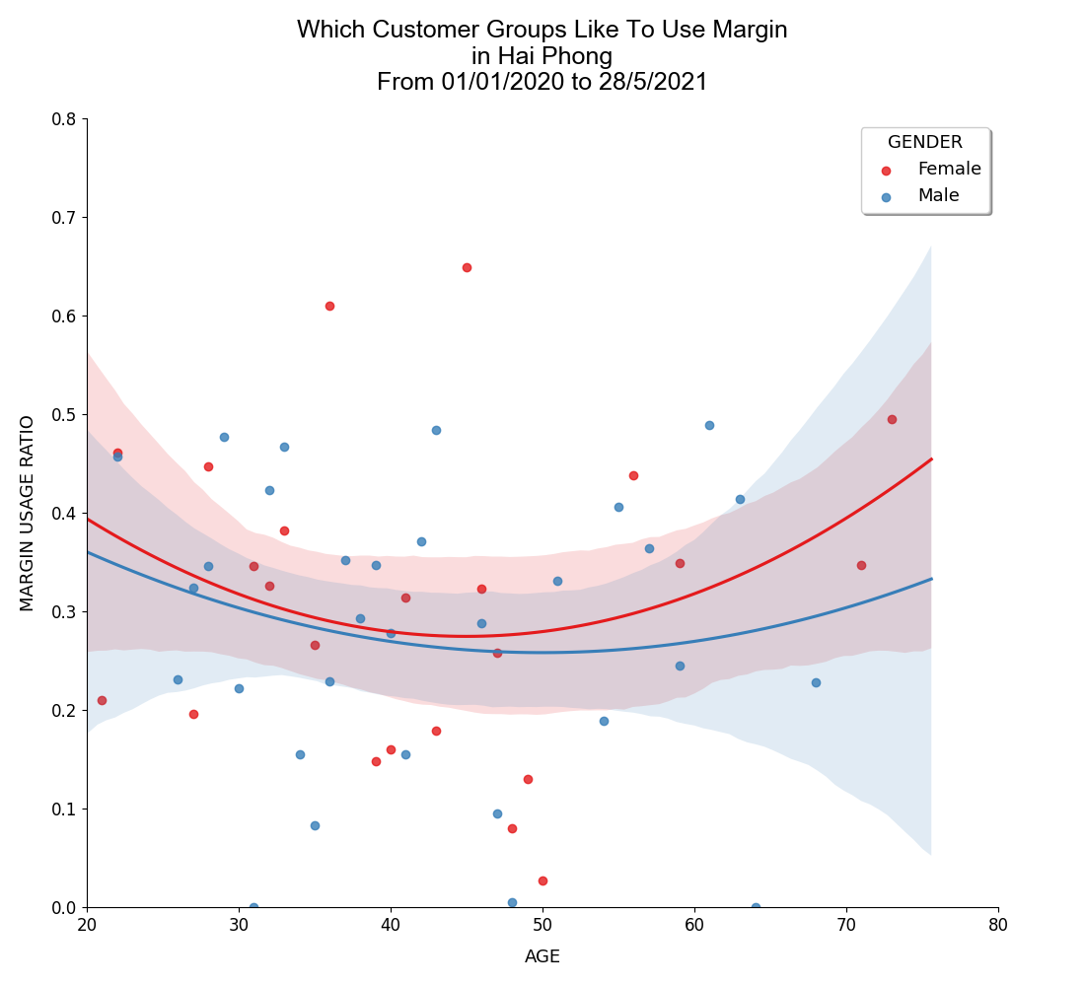
HAI PHONG - ON MARGIN PREFERENCE TRADING, ACTIVE, individual, margined customers
››› Next page for further analysis

Slide 27
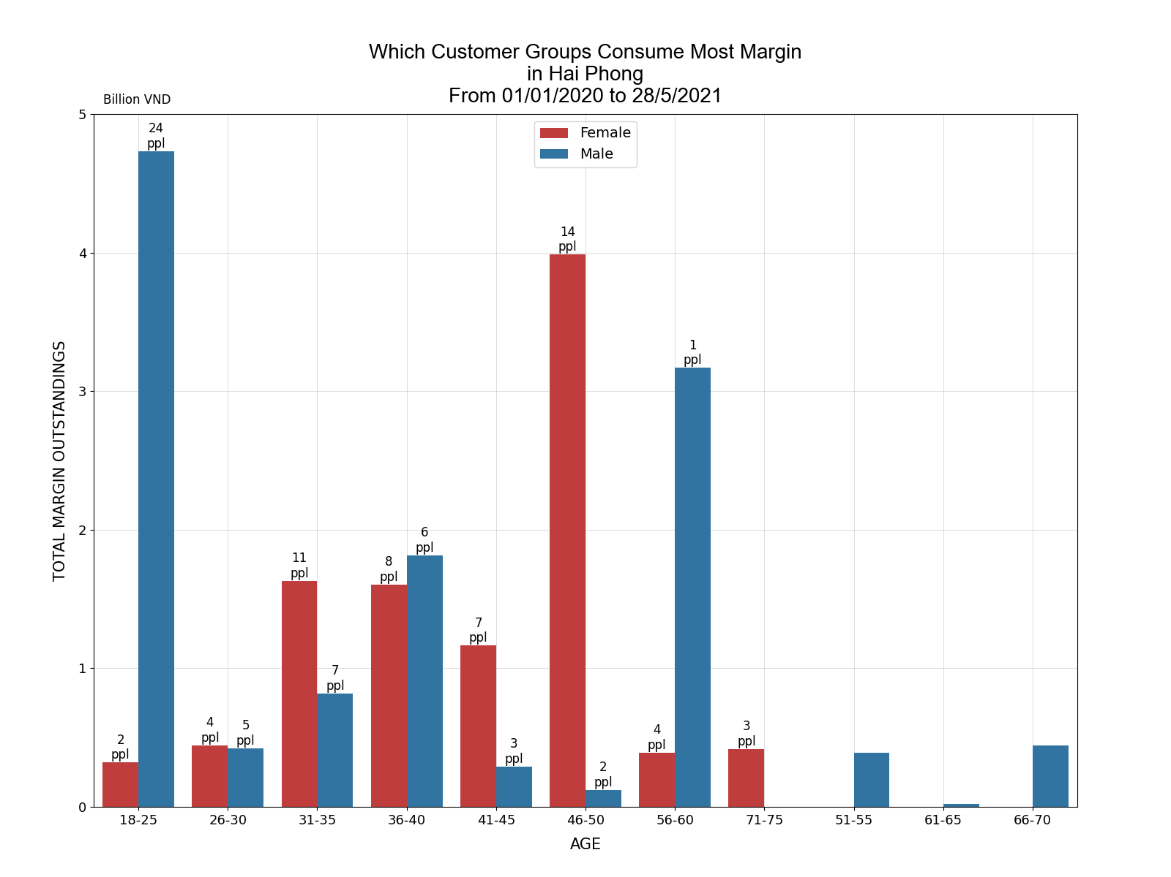
HAI PHONG - total margin outstandingS TRADING, ACTIVE, individual, margined customers
ppl: people in age group
There is not so many margined customers in Hai Phong to make a confident regression analysis on margin usage. Most age number are only backed by less than 5 customers in both genders and there is never enough 10 margined customers of same gender, having a common age. As a result, a good predictor could rely entirely on average margin outstandings per customer, from which we could commit ourselves to target to female customers of all ages and male customer aging from 56 to 60 to optimize our profit in margin offerings.

Slide 28
NEXT STEP

Slide 29
next step
Our next step is devoted to grouping technique which forms the building block of later statistical model. This model then predicts expected income yielded by any single new customer given their demographic information:
Location
Area
Gender
Account Type
Expected Income for the company
Model
Expected Delivery Date: 25/06/2021

Slide 30

Thank You

